Slide 1
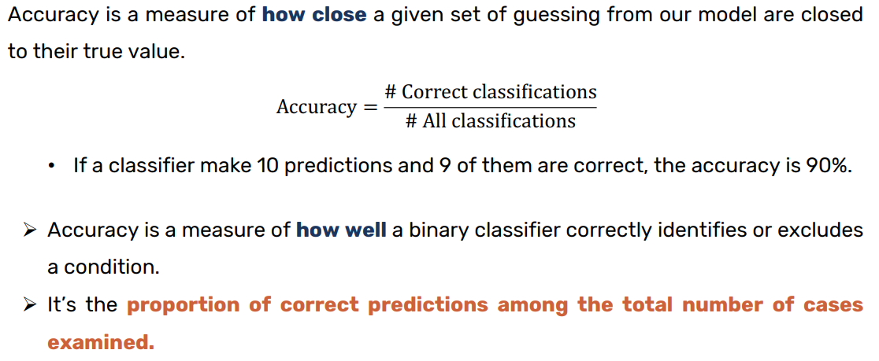
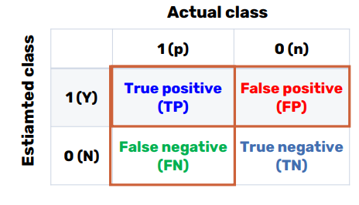
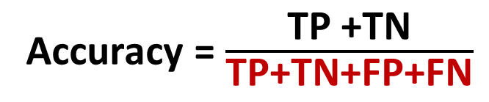
Accuracy
Confusion Matrix
Accuracy = $\frac{\text{TP}\text{ +}\text{TN}}{\text{TP}\text{+}\text{TN}\text{+}\text{FP}\text{+}\text{FN}}$
Accuracy = (11+11)/ (11+0+1+11)
= 22/ 23 = 95.6 %

Slide 2
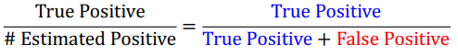
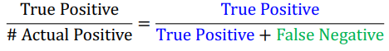
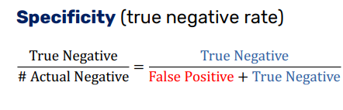
Precision and Recall
Precision =
(How much precise we are in the detection)
Sensitivity/Recall =
(How much we are good at detecting)

Slide 3
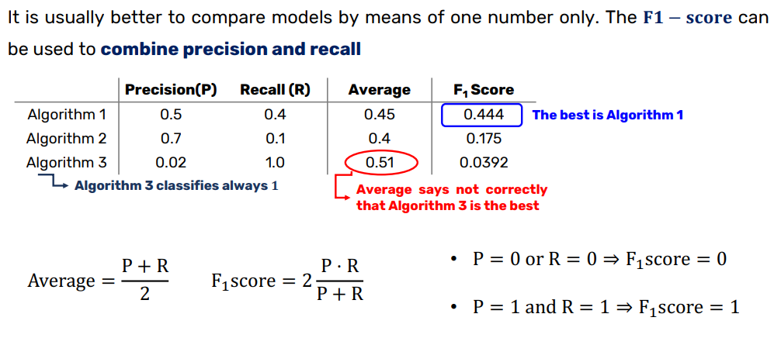
F1-score

Slide 4
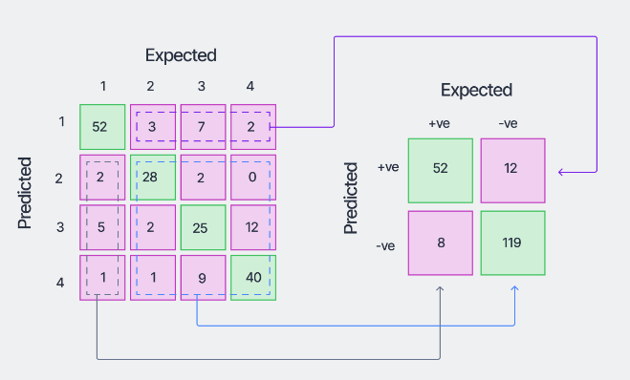
Confusion matrix for multiclass problem
Convert to one-vs-all (for class-1)

Slide 5
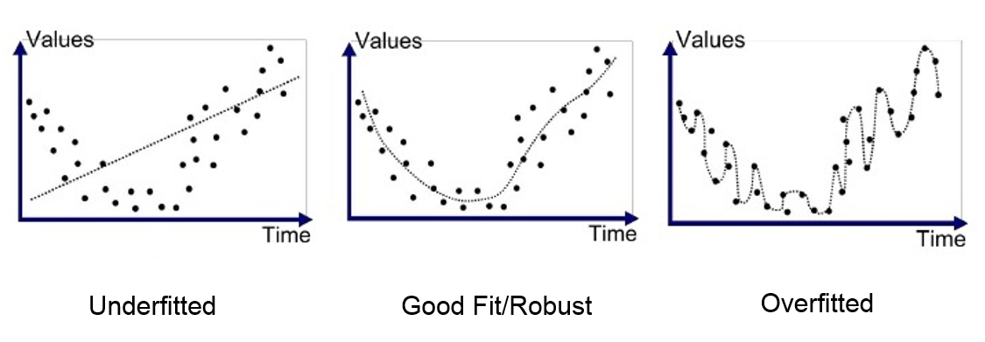
Underfitting vs. Overfitting
Underfit: An underfit model is one that isn’t complex enough to match the available data because it can’t replicate all of the observed changes.
Overfit: An overfit model is one that is too complex for the available data. The high complexity allows the model to have too many changes for the data set, creating curves and variations that don’t actually exist.

Slide 6
Bias
Variance
Bias describes how well a model matches the training set.
A model with high bias won’t match the data set closely
A model with low bias will match the data set very closely.
Variance describes how much a model changes when you train it using different portions of your data set.
Even if the training data changes slightly, the model parameters should change
If a model changes dynamically (unstable) -> high variance
Bias vs. Variance
A model that is not flexible enough to match a data set correctly (High bias) is also not flexible enough to change dramatically when given a different data set (Low variance).
Models with high bias will have low variance.
Models with high variance will have a low bias.

Slide 7
Which of the following model suggests more assumptions about the target functions?
Model with low bias
Model with high bias
Which of the models tend to have high-bias?
Linear regression
Decision tree
Logistic regression
K-NN
Linear Discriminant Analysis
SVM
Which type of model is ideal?
Low bias and high-variance
High bias and low-variance
1. Linear regression: Assumes a linear relationship between the independent variables and the dependent variable.
2. Logistic regression: Assumes a linear relationship between the independent variables and the log-odds of the dependent variable being in a particular category.
3. Linear Discriminant Analysis (LDA): Assumes that the features are normally distributed and that the classes have identical covariance matrices.
These models are generally more interpretable and efficient but may not capture complex relationships in the data as well as models with lower bias.
Models with high bias make simpler assumptions about the data, reducing the risk of overfitting. Examples include linear regression, logistic regression, and linear discriminant analysis.
On the other hand, models with low bias and high variance can capture complex relationships but are more prone to overfitting. They may perform well on training data but poorly on unseen data. Examples- decision tree, KNN
Notes:
Low bias

Slide 8
Which of the models tend to have low-variance ?
Linear regression
Decision tree
Logistic regression
K-NN
Linear Discriminant Analysis
Which of the models tend to have high-variance ?
Decision trees
Linear regression
Logistic regression
Perceptron (single layer)
K-NN
SVM
Models with high bias and low complexity tend to have low variance.
- Linear regression
- Logistic regression
- Linear Discriminant Analysis
These models have relatively simple structures and make strong assumptions about the underlying data, which often results in low variance.
The models that tend to have high variance are those that are more flexible and capable of capturing complex relationships in the data. They are prone to overfitting.
- Decision tree: Decision trees tend to have high variance, especially if they are deep and unconstrained. They can learn intricate patterns from the data, which can lead to overfitting.
- K-NN: K-NN can have high variance, especially with small values of k. With smaller values of k, the decision boundaries can be highly influenced by noise in the data, leading to overfitting.

Slide 9
Error
Reducible Error
the element that we can improve
Bias and Variance
Irreducible error
elements outside our control, such as statistical noise in the observations
Model Error = Reducible Error + Irreducible Error

